Slide 1

SDM Queue Management
Project Sponsor: Girija Sahoo
Green Belt Associate: Surbhi Bansal
Project Mentor: Rajesh Taneja
Master Black Belt Mentor: Thomas Prasad V
Project ID - 301703
February 24th, 2014
TCS Internal

Slide 2
Project Selection
# | Parameters | Considered | Remark
1 | Is there a Customer &/or Internal impact / benefit? |  | Tangible & intangible
2 | Does this project help realize Customer’s business goals? |  | Cost reduction
3 | Do you know the business objective? |  | Customer satisfaction
4 | Is the Sponsor willing to provide resources? |  | Key SME identified by sponsor
5 | Can the project be done in 6~9 months? |  | Rigor to complete the project
6 | Is the project scope within control of the Project Team? |  | Onsite & offshore team collaboration
7 | Can the benefits be quantified in money value? |  | Cost saving in $
8 | Is there a benefit to stakeholders? |  | Customer & delivery team

Slide 3
Project Charter
Business Case (Including High Level Benefit Analysis)
Specific Goal Statement
Functional Queues are used as part of the pharmacy workflow steps required
These queues are combined view of all the prescription at a particular workflow step.
There are following common features for all the queues required :-
  Sorting
  Alternate Row Coloring
  Layout
  Caching
  Manual Refresh of data
  Auto Refresh of data at a particular interval
Time to Construct new queues to be reduced by 40% before 30 Sept 2014
In Scope
8 Functional Queues
Out of Scope
Filtering
Outbound Contact Queue
Locking
Pagination
Specific Problem Statement
On an average it takes 20 PD’s of developers effort to build 1 queue.
All the queues required have lot of common features and only the data gets changed in the
Queues so the construction of the queues will take more time in implementing each queue
differently. If there are new requirements then we will have to again spend same time for each
new queue.
Hence there is a need to develop a Queue Framework to reduce overall development effort.

Slide 4
Alignment to Business Big Y
Business Big
Customer Satisfaction
Defect Prevention & Reduction, Defect Free Deliverables
Industry CTQ
y₁
y₂
y₃
Project CTQ: characteristic
Defects, Effort & Cycle Time
y_{A}
y_{B}
y_{C}
Measurable
y
Number of Defects

Slide 5

Project Scope
C
O
P
I
S
C
O
P
I
S
Customer
Output
Process
Input
Supplier
(Use nouns)
Start
(Use verbs)
Stop
(Use nouns)
Unit Testing Result
Queue Framework
Java Code
Developer
Write Queue
Framework Code
Start Unit Test
case Execution
Is Test Case pass?
Unit Testing
Complete
Yes
No

Slide 6
As-Is Value Stream Map
Non value added activity
Value enabling activity
1 Hr.
.
Value added activity
User/Customer
4 Hr.
Project Setup
Commit Files
Processing Time
SDLC
Get the
Requirements
Design
Code and Unit
Test
QA
Integrate
9 Hr
9 Hr
29 Hr.
9 Hr.
9 Hr.
Users/Customer
Common
Requirements
Common
Design
Common
Code and Test
Common
QA
9 Hr.
27 Hr.
54 Hr.
18 Hr.

Slide 7
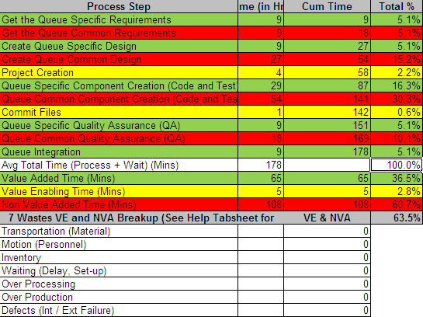
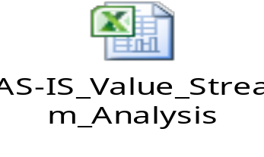
AS IS Process Value Analysis

Slide 8
AS IS - Waste Category Identification
Waste Analysis:
W- Waiting: Delay/setup:-
On normal occasions, after the components are identified , a lot of time is wasted in doing the coding to make components like Controller, Service, DAO and configuration files.
O- Over Processing: Rework
There is possibility for error while manually creating the required components as per standards and that has to be resolved. This leads to wastage of time and resources.

Slide 9
Lean Analysis
Operation | Problem | Proposed Action | Results | Waste Reduction
Pharmacy Queue Implementation | All the queues required have lot of common features and only the data gets changed in the Queues so the construction of the queues will take more time in implementing each queue differently. If there are new requirement s then we will have to again spend same time for each new queue. | There is a need to develop a Queue Framework to reduce overall development effort. | Reduced the overall effort in developing queues with improved quality and reduced defects | Effort and Cycle Time
Before Kaizen
User has to get the common requirements and write the common design and code for each new queue.
After Kaizen
With the introduction of queue framework, the developer only needs to customize the queue for any new requirements.

Slide 10
TO BE Process
Non value added activity
Value enabling activity
1 Hr.
.
Value added activity
User/Customer
4 Hr.
Project Setup
Commit Files
Processing Time
SDLC
Get the
Requirements
Design
Code and Unit
Test
QA
Integrate
9 Hr
9 Hr
29 Hr.
9 Hr.
9 Hr.
Users/Customer

Slide 11
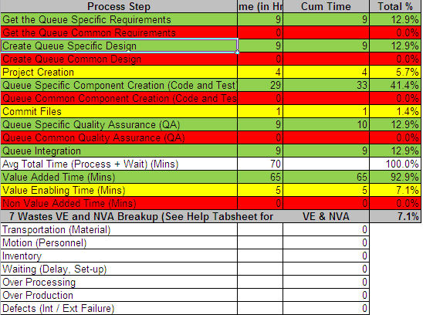
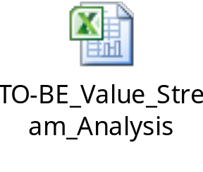
TO BE Process Value Analysis

Slide 12
TO BE - Waste Category Identification
Non Value Add activities removed – Queue Framework Used

Slide 13
Cost Benefit Analysis
 | Effort in PD's
 | Count | Requirement | Design | Code | Test | Integrate
Queue Creation (As per SDLC Effort) | 9 | 2 | 4 | 10 | 3 | 1
Queue Creation Total Effort |  | 18 | 36 | 90 | 27 | 9 | 180
PI
Queue Framework | 1 | 4 | 5 | 15 | 8 | 0
Queue Framework Implementation | 9 | 1 | 1 | 4 | 1 | 1
Framework Development |  | 4 | 5 | 15 | 8 | 0 | 32
Framework Implementation |  | 9 | 9 | 36 | 9 | 9 | 72
Effort Saved (in PD's) | 76
%Savings | 42.22%
Per Hr Billing Rate (in CAD) | 26.79
Effort Saved (in Hrs) | 684
CAD Savings | 18324

Slide 14

Achievement
Achieved 42.22% effort reduction against target of 40%

Slide 15

Thank You

